Slide 1


Artificial Intelligence (Machine Learning & Deep Learning)
NAVTTC & Strings Technologies
by Salman Ahmad

Slide 2
Outline Week 8 Day 2 & 3
Long-Short Term Memory (LSTM)
Learning from Sequences over Time

Slide 3
What is LSTM?
LSTM stands for Long Short-Term Memory network.
It’s a special kind of RNN designed to capture long-range dependencies in sequences.
Proposed by Hochreiter & Schmidhuber (1997), 11 years after simple RNN.
Especially useful in NLP, time series, and speech processing.

Slide 4
Why Not Use Vanilla RNN?
Problem: Vanishing/Exploding Gradients
In RNNs, as we backpropagate over time, gradients often:
Vanish (become too small → no learning)
Or explode (become too large → unstable learning)
This makes it hard for RNNs to remember long-term context (e.g., 20+ steps)
LSTM solves this!

Slide 5
Core Idea Behind LSTM
LSTM introduces gates and a cell state.
Gates are learnable control mechanisms to decide:
What to keep
What to throw away
What to add
Think of it like a conveyor belt (cell state) that flows through the network with minor regulated updates.

Slide 6
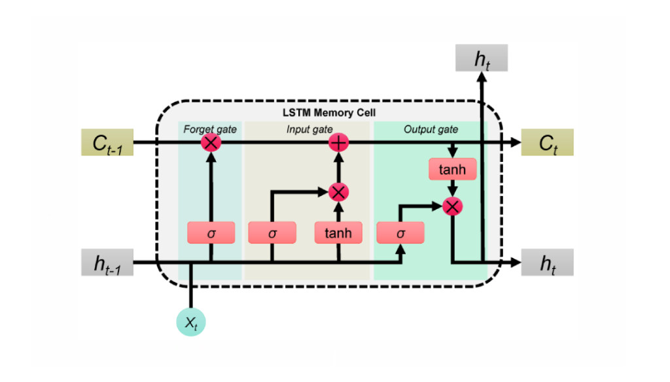
LSTM

Slide 7
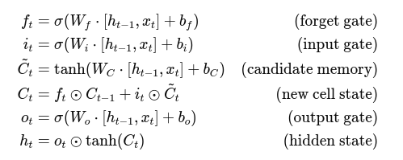
LSTM Architecture (Per Time Step)
LSTM has:
Forget Gate: Decides what to discard
Input Gate: Decides what new info to store
Cell State C_{t}: Long-term memory
Output Gate: Decides what to output

Slide 8
LSTM Flow Diagram
Cell state C_{t} flows straight down the chain
Gates regulate what gets added/removed at each step
Hidden state h_{t} carries current output
Allows learning when to remember or forget

Slide 9
How LSTM Solves RNN Problems
Problem in RNN | LSTM Solution
Vanishing gradient | Cell state preserves information via identity connections
Long-term memory | Forget/input gates selectively store/erase
No control mechanism | LSTM gates explicitly learn memory control

Slide 10
When to Use LSTM?
Use Case | Why LSTM?
Sentiment over long documents | Remembers earlier sentence tone
Language modeling / translation | Tracks long grammar dependencies
Time-series prediction | Maintains trends over time
Speech synthesis | Captures syllables/phonemes

Slide 11
RNN Limitations
Struggles with long-term dependencies
Sequential processing limits parallelism
Training is slow and sometimes unstable
LSTM and GRU were developed to fix these issues

Slide 12
LSTM in TF/Keras
from tensorflow.keras.models import Sequential
from tensorflow.keras.layers import Embedding, LSTM, Dense
model = Sequential([
Embedding(input_dim=10000, output_dim=64),
LSTM(units=64, return_sequences=False),
Dense(1, activation='sigmoid')
])
return_sequences=False: returns only last output
Use return_sequences=True when passing to another RNN layer

Slide 13
Summary
LSTM is a smart memory unit that can learn what to remember.
Solves vanishing gradient and long-term dependency problems.
Widely used in NLP, time-series, and speech tasks.
A building block for more advanced models like BiLSTM, Seq2Seq, Attention, and Transformers.

Slide 14

Questions?
"He who asks a question is a fool for a minute; he who does not remains a fool forever." – Confucius

